Slide 1
Fandom publics: The Internet and New Social Formation in China
Weiyu Zhang
Department of Communications & New Media
National University of Singapore
Notes:
One book

Slide 2
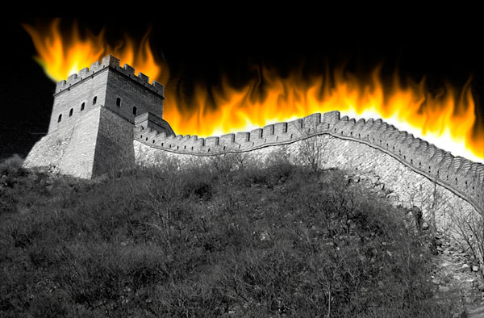
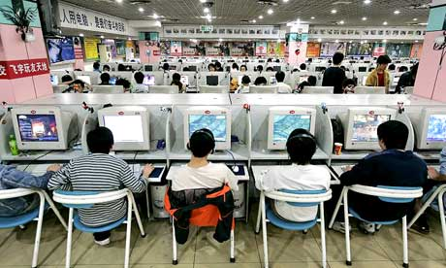
The two faces of networked China

Slide 3
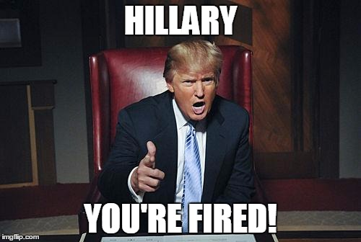
Notes:
The apprentice

Slide 4
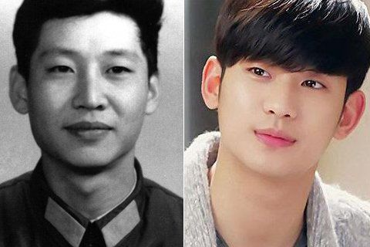
From Entertainment to Politics?
Notes:
My lover from the star, 2014
Watched 26 billions times alone on iqiyi

Slide 5
Method: In-depth interviews
Study 1
Study 3
American Idol
America's Next Top Model
The Amazing Race
The X-Factor US
Survivor
So You Think You Can Dance
America's Got Talent
The Voice US
Kpop Star
We Got Married
The Romantic & Idol
Running Man
Britain's Got Talent
Participant observation in communities
  Yeeyan, yizhe, yiai, dongxi, YYeTs, YDY, TLF, ocourse, etc
Interviews with 16 translators
  8 from Yeeyan (active members, managers)
  3 from Yizhe
  1 from Dongxi
  3 from TLF
  I from ocourse
Notes:
13 bars, 23 interviews

Slide 6
Method: study 2
Textual analysis
  36,000 users and 126,546 posts as of July 17, 2014.
  Categorization of all posts
  Posts with 100 and above replies
  Recurring themes

Slide 7

Notes:
Based on the original The Voice of Holland, the concept of the series is to find new singing talent (solo or duets) contested by aspiring singers drawn from public auditions. The winner is determined by votes cast by a media judging panel and live audience.
The show began airing under the name of The Voice of China on 13 July 2012. In 2016, contractual disputes arose between Talpa Holding, the owner of the show's format and franchise, and Canxing Production, the show's producing company. It was revealed the former has inked a joint venture with another producing company, Talent International, to produce the upcoming seasons of the show. In a response to the dispute and prevent copyright breaches, Canxing Productions launched Sing! China, a rebranded version of the show which the producers claimed to come with an original format, though it still shares several similarities with The Voice of China
Canxing has paid 8 million euro per year for copyright fee since 2013. and the price is raised to 13 million euro a year in 2016.
http://www.thepaper.cn/newsDetail_forward_1494769

Slide 8
Transcultural TV in China
Transcultural TV refers to TV programs that originate from a culture other than that of the contemporary mainland China since 1949.
The birth of Chinese TV and the invention of Chinese TV audiences were transcultural
The development of Chinese TV is also highly influenced by transcultural forces
Notes:
Early years(1958-1978): The state offered the financial support to purchase foreign content from countries that are part of the Soviet bloc in order to ensure the correctness of ideological doctrine. Huang and Yu (1997) reported that in 1959 alone, China imported about 1,000 TV programs and 459 of which were from Hungary while those from former Soviet Union were 349
A significant setback during the Cultural Revolution
After 1978: state-controlled TV broadcasters resumed the import of foreign TV content in order to deal with the challenges coming along with marketization
Till the 1990s, the so-called capitalist countries became the major suppliers of foreign TV content
Now Chinese TV stations are able to imitate the foreign TV content to produce their own popular hits

Slide 9
The Online Sphere of Transcultural TV Fandom in China
During the pre-Internet period, the format of transcultural TV fandom expression was supported by offline mechanisms such as fan clubs and print publications. Pirate VCD industry played a pivotal role in disseminating transcultural TV content
Broadband Internet in the 2000s fosters file sharing sites and online fan communities
  Discussions over foreign TV shows were first scattered in various online forums, such as BBSs associated with subtitle groups, forums hosted by major web portals, and independent online forums.
  From around 2005, fans of foreign TV shows began to migrate to Baidu Post Bar gradually. By the year of 2009, Baidu Post Bar defeated all its competitors and became the most popular space for fans of foreign TV shows to gather and share.

Slide 10
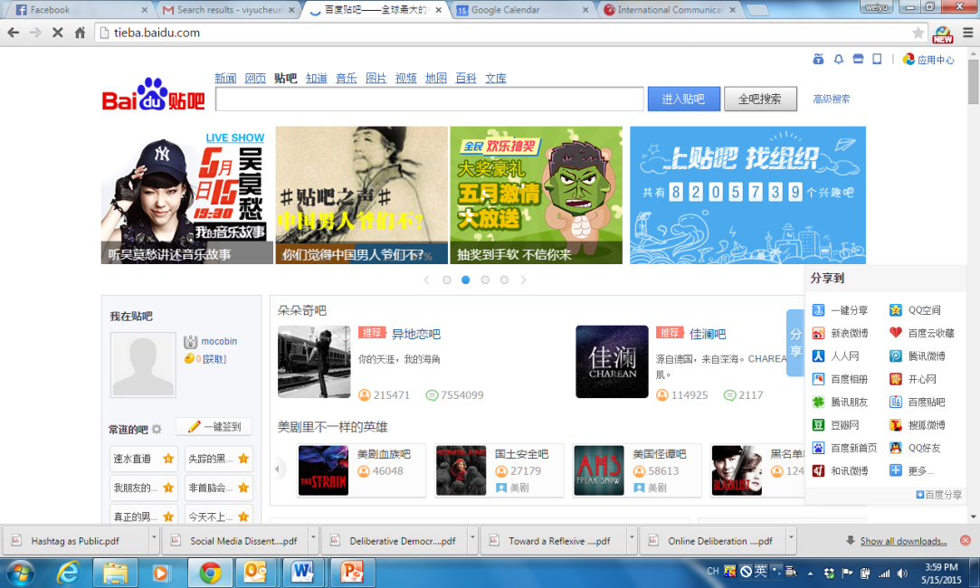
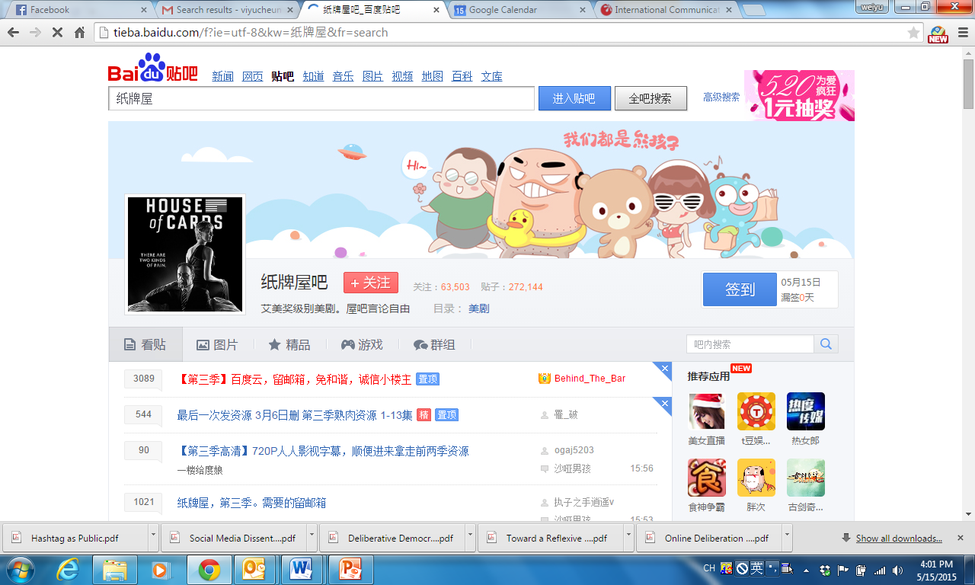
Baidu Post Bars
Notes:
At the end of 2012, Baidu Post Bar hosts 600 million registered users and over four million bars (163.com, 2012).

Slide 11
Research questions
How do the fans prosume transcultural media products such as reality TV shows?

Slide 12
Watching TV on the Internet
Why?
  Some shows are banned
  Delayed import
  Interrupted import
How?
  Official websites that provide free live-podcasting
  Local video sites that bought copyright
  Subtitle groups (study 3)
Notes:
An experience independent of the medium of tv
One interviewee saw amazing race on shanghai tv but no longer watch it on tv
Internet provides a free, real-time, and non-disrupted access

Slide 13
Watching TV on the Internet
Watch the original live podcasting together
  Live-broadcasting posts
Produce/watch the translated version
  Online discussions re-shaped first time impression
  Localized translation
Edit the cuts, write support posts, engage in debate posts, go offline…
Notes:
Communal rather than individual

Slide 14
Attractions
either the format of the shows or the stars featured in the shows
  British/American vs. Korean
Featuring ordinary people who have talents
Fair competition
Individualism
Quality

Slide 15
Research questions
What do the fans get out of transcultural media products such as “House of Cards”?
Notes:
Does such consumption contain the potential of criticizing or at least reflecting on local political realities?

Slide 16

House of Cards
Different from other popular American political TV dramas such as The West Wing, this TV series depicted American politics in a highly cynical and dark way
The dissemination and consumption of this political drama is dominantly online: Netflix, Sohu Videos, and more
Notes:
The official dissemination of this TV drama in China was initiated by Sohu’s online video channel in 2014 when Sohu streamed season 2 simultaneously with Netfix
The first season of the TV drama has been viewed 94 million times and the second season 92 million times on sohu
161k users and 409k posts

Slide 17
What do fans say on Post Bar?
resource posts are those that include videos, pictures, music, e-books, quotes, news, and even ringtones relevant to the series
discussion posts about the show are centered on the characters, the plots, the lifestyles, and the context shown in the series
extended discussions often go beyond the show to talk about the comparisons between Chinese and American politics as well as the comparisons between American TV dramas and Chinese or Korean TV dramas
miscellaneous posts

Slide 18
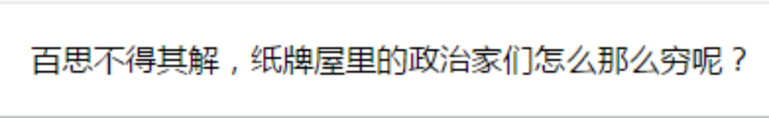
Authentic vs. unauthentic
Regardless of the issues being explained and discussed, the fans seemed to trust the authenticity of the show and often used historical events (e.g., the Watergate) and real examples (e.g., the salary of Obama) to prove that the show was honestly depicting the reality of American politics.
      “Impossible to understand: Why are the politicians in the show so poor?”
Notes:
The female protagonist betrayed her husband for a sponsorship worthy of 200k

Slide 19
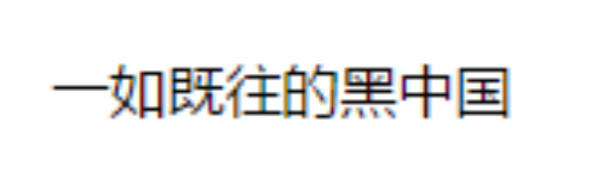
Authentic vs. unauthentic
The fact that there were significant disagreements among the fans regarding the authenticity of such details indicates the double standards many fans used when evaluating the realness of this show.
The issue of authenticity thus becomes a matter of personal experience.
“Stigmatize China, as usual”

Slide 20
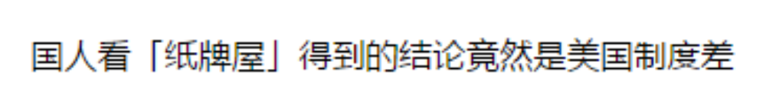
Foreign/indigenous
The “foreignness” of doing politics in the US indeed became a source of viewing pleasure for the fans when the comparison posts listed point by point how the ways of doing politics in the US would fail in China
However, the discussions following such comparisons often ended with contrasting conclusions, depending on personal experience.
“After watching the show, Chinese concluded that American system is even worse?!”
Notes:
Male protagonist killed two people with his own hands

Slide 21
Identity
Being Chinese, rather than carrying out certain values and cultural conventions, is identified as having to live in the Chinese reality.
Now and here

Slide 22
Research question 3
What have been transferred from fandom of transcultural media products to opencourse translations?

Slide 23
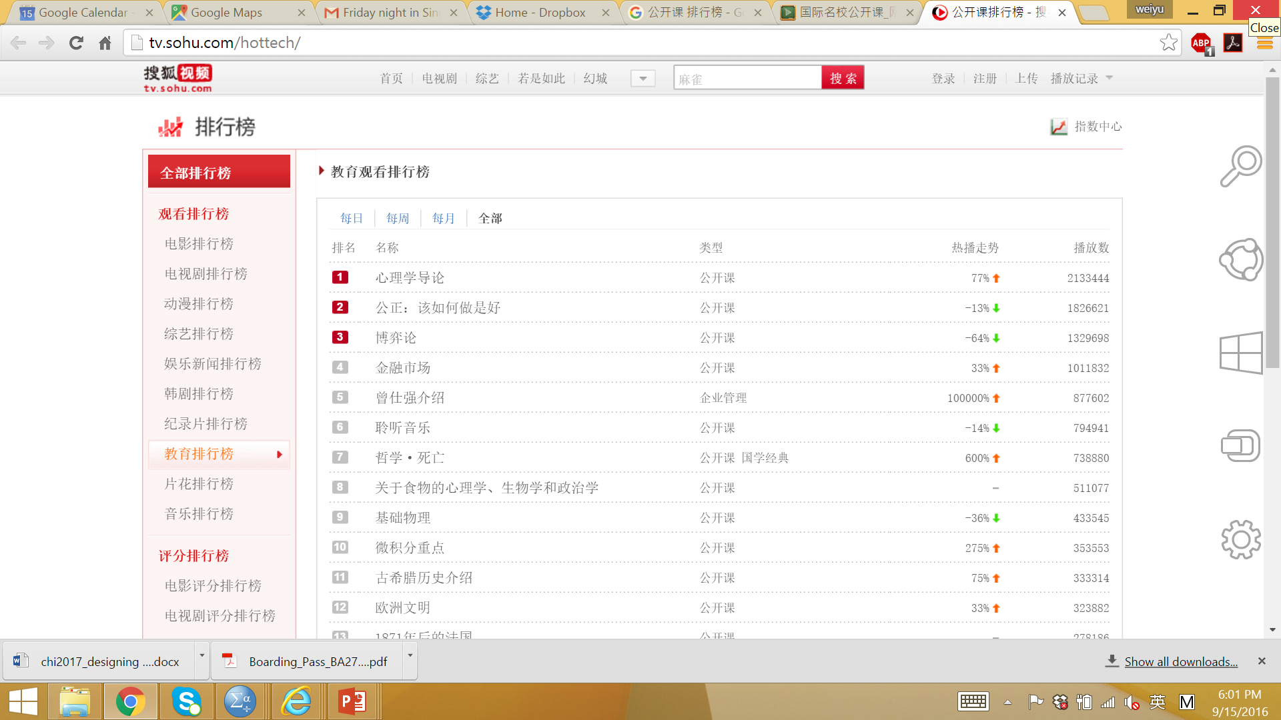
Open Course

Slide 24


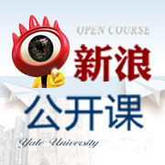











Open Course

Slide 25
Bring fans into politics
Henry Jenkins
Participatory media culture → participatory political culture
  skills
  sense of agency
  mindset of collaboration
  structures of collaboration

Slide 26
Transfer
Skills
  Language
  Crowd sourcing
Sense of agency
  “我是因为自己喜欢 才来做字幕 说的不好听一点 我不希望别人把这个字幕做坏了 所以我自己来做” (Judy, TLF)
Collaboration mindsets
  The astrophysics case

Slide 27
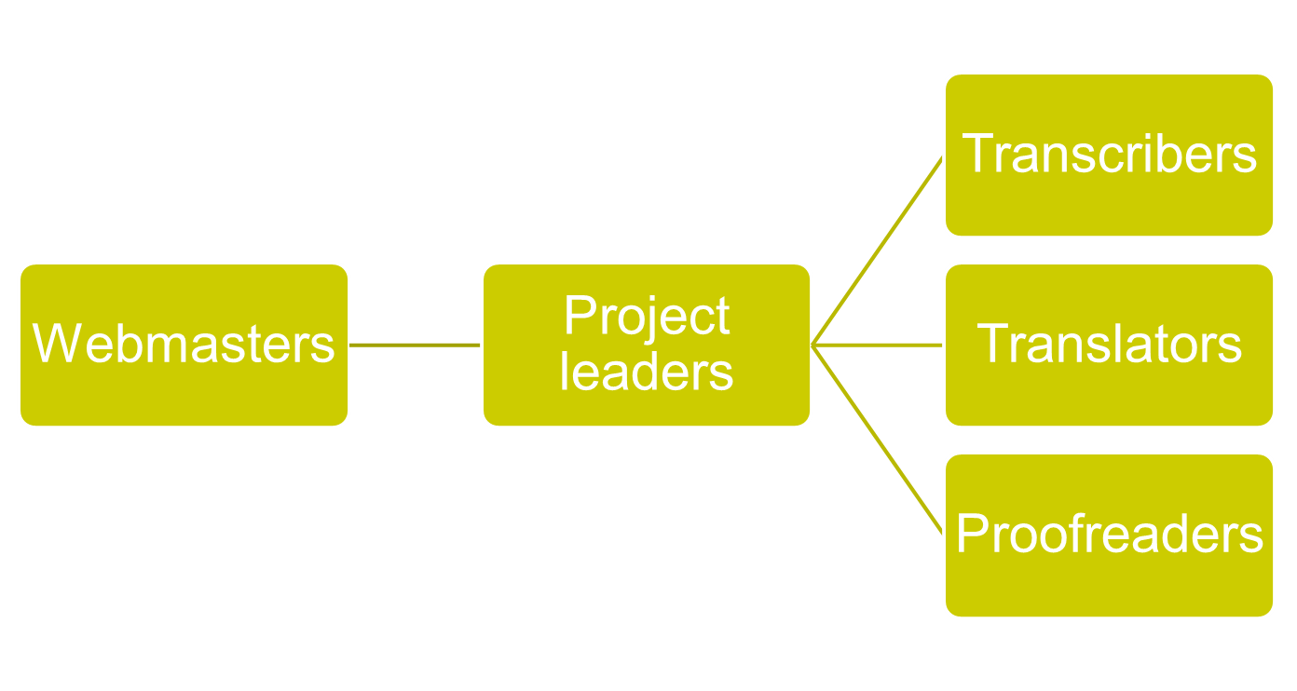
Virtual Structure
Technicians
Notes:
Transportation editor
Source editor
Timeline editor
Transcribers
Translator
Proofreader

Slide 28
FROM FANS TO PUBLICS
Notes:
Build capacity for collective action through fan activities – hands
Use foreign shows to re-configure the Chinese identity – minds
Based on this re-configured identity and enhanced capability, make collective actions to address collective issues
Take the control over information flow in their own hands
Make great firewall in fact dysfunctional

Slide 29
Thank you!
Twitter: Weiyuz
Weibo: 张玮玉
www.weiyuzhang.net

Slide 30
Why not local shows?
JIA - the opposite of being truthful, or sincere, or authentic, or original.
  many local reality shows copied the format of successful foreign shows and therefore, were rarely original.
  the local versions were not consistent with the original versions.

Slide 31
Why not local shows?
  local reality shows tend to sell melodramas more than other components.
  dramas should not be scripted, rehearsed and staged, but should naturally emerge during the process of competition.
  some dramas in local shows are completely untruthful.
  some contestants over-emphasize their pitiful life in order to gain sympathy from the audiences.

Slide 32
Reasons of Jia?
the close control on the content from the government, which has put many constraints on local producers to work creatively
the over-commercialization of local shows
  Make fast money
  Subtle and appropriate commercialization

Slide 33
Reasons of Jia?
Cultural differences
  Chinese culture stresses on harmony and the local shows tend to emphasize the image of one big family, which makes the show look pretentious.
  Chinese culture puts work in front of leisure and entertainment is considered meaningless activities
Notes:
Lack of spirit of entertainment in both producers and consumers

Slide 34
How do the fans perceive the impacts of their active consumption of transcultural content on themselves?
became more knowledgeable about the subject
became more knowledgeable about the culture/country of origin
denied that the foreign reality shows have changed their world views and core values
agreed that their ability to judge the quality of reality shows was enhanced

